Slide 1
Electric Potential of a Parallel Plate Capacitor

Slide 2
Characteristics of a Capacitor
+
+
+
+
+
+
+
+
+
+
+
++++
-
-
-
-
-
-
-
-
-
-
-
----
Two equal and oppositely charged plates
q_{o}
Uniform Electric Field
B
q_{o}
E = CONSTANT
C
q_{o}
A
Since the electric field is constant, the force acting on a charged particle will be the same everywhere between the plates.
F_{e} = q_{o}E
F_{A} = F_{B} = F_{C}

Slide 3




Work moving a charge through an electric field in a Capacitor
+
+
+
+
+
+
+
+
+
+
+
++++
D
-
-
-
-
-
-
-
-
-
-
-
----
$$W_{AB}=Fd_{B}−Fd_{A}$$
A
B
q_{o}
q_{o}
F = q_{o}E
F = q_{o}E
$$WAB=qoEd$$
d_{B}
d_{A}
C
q_{o}
What if instead of traveling from point A to point B, the charge moved from point C to D?
If $WAB=qoEd$, then what is W_{CD}?
W_{CD} = 0 Joules because the force acts perpendicular to the direction of motion.
  Do you remember that W = F·d·cosθ?

Slide 4


Electric Potential of a Capacitor – An alternative
From mechanics, $W=Fd$.
From the previous slide, $W=qoEd$
From the reference table, $V=W/qo$
$$V=\frac{W_{AB}}{qo}$$
$$V=\frac{Fd}{qo}$$
$$V=\frac{qoEd}{qo}$$
$$V=Ed$$
+
+
+
+
+
+
+
+
+
+
+
++++
-
-
-
-
-
-
-
-
-
-
-
----
Two equal and oppositely charged plates
A
B
q_{o}
F = q_{o}E
Uniform
Electric
Field
d

Slide 5
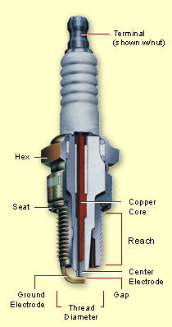




Example 5:Parallel Plates
A spark plug in an automobile engine consists of two metal conductors that are separated by a distance of 0.50 mm. When an electric spark jumps between them, the magnitude of the electric field is 4.8 x 10⁷ V/m. What is the magnitude of the potential difference V between the conductors?
$$V=Ed$$
$$V=(4.8×{10}^{7} V/m)(5.0×{10}^{−4} m)$$
$$V=24,000V$$
d

Slide 6
Example 4: Parallel Plates
A proton and an electron are released from rest from a similarly charged plate of a capacitor. The electric potential is 100,000 V and the distance between the two plates is 0.10 mm.
  Which charge will have greater kinetic energy at the moment it reaches the opposite plate?
  Determine the amount of work done on each particle.
  Determine the speed of each particle at the moment it reaches the opposite plate.
  Determine the magnitude of the force acting on each particle.
  Determine the magnitude of the acceleration of each particle.

Slide 7
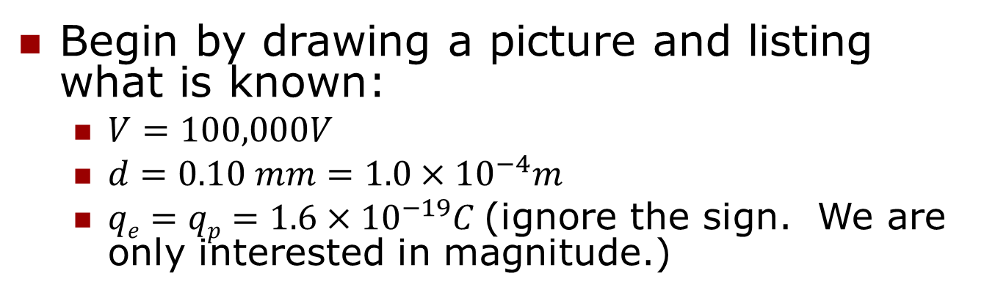
Example 4: Parallel Plates(cont.)
+
+
+
+
+
+
+
+
+
+
+
++++
-
-
-
-
-
-
-
-
-
-
-
----
p⁺
e⁻
d
Begin by drawing a picture and listing what is known:
  $V=100,000V$
  $d=0.10 mm=1.0×{10}^{−4}m$
  $qe=qp=1.6×{10}^{−19}C$(ignore the sign. We are only interested in magnitude.)

Slide 8
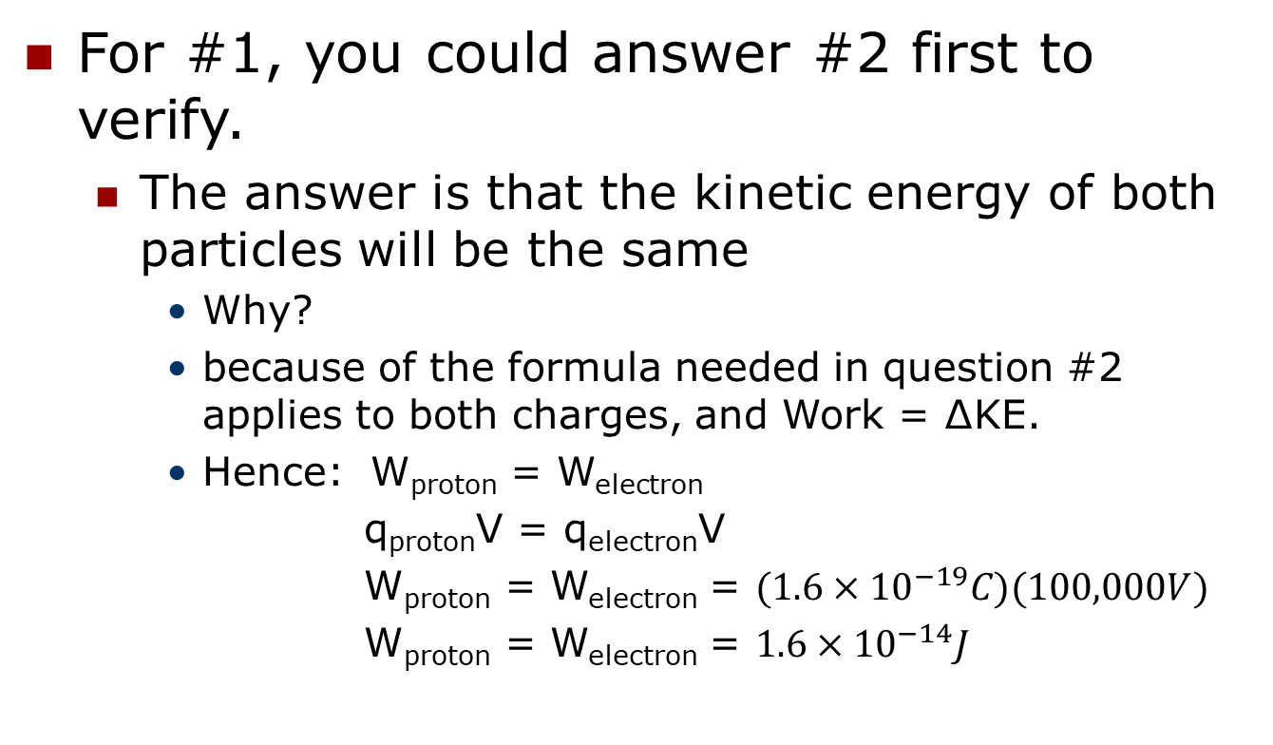
Example 4: Parallel Plates(#1 & #2)
For #1, you could answer #2 first to verify.
  The answer is that the kinetic energy of both particles will be the same
    Why?
    because of the formula needed in question #2 applies to both charges, and Work = ∆KE.
    Hence: W_{proton} = W_{electron}
    q_{proton}V = q_{electron}V
    W_{proton} = W_{electron} = $(1.6×{10}^{−19}C)(100,000V)$
    W_{proton} = W_{electron} = $1.6×{10}^{−14}J$

Slide 9
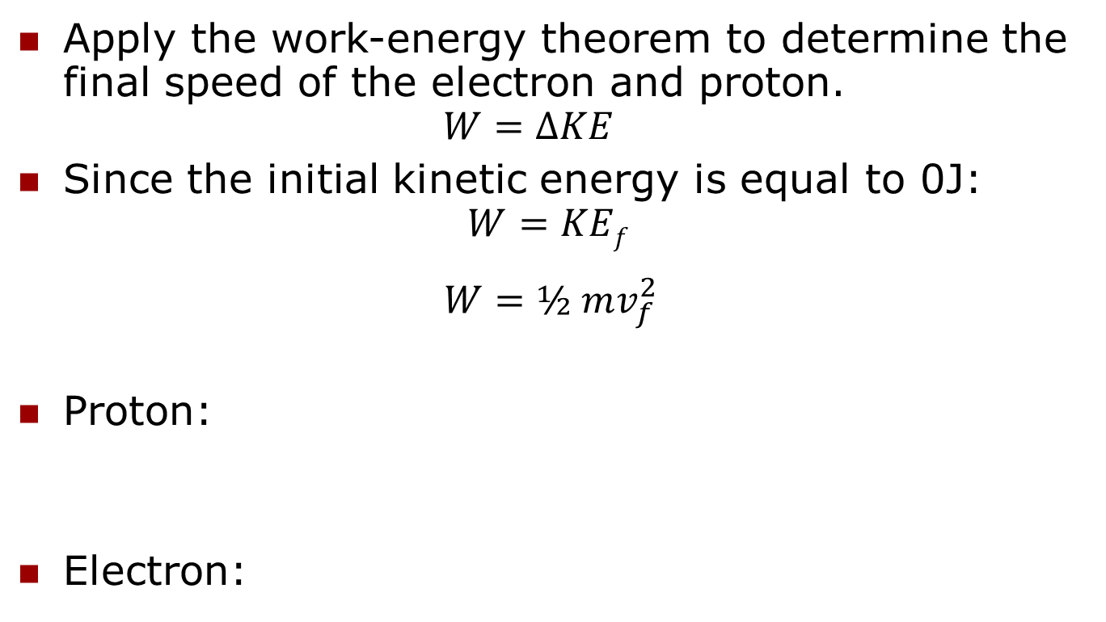
Example 4: Parallel Plates(#3)
Apply the work-energy theorem to determine the final speed of the electron and proton.
$$W=∆KE$$
Since the initial kinetic energy is equal to 0J:
$$W=KEf$$
$$W=½ mv_{f}^{2}$$
Proton:
Electron:

Slide 10
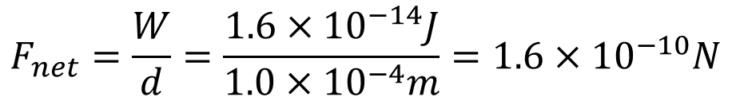
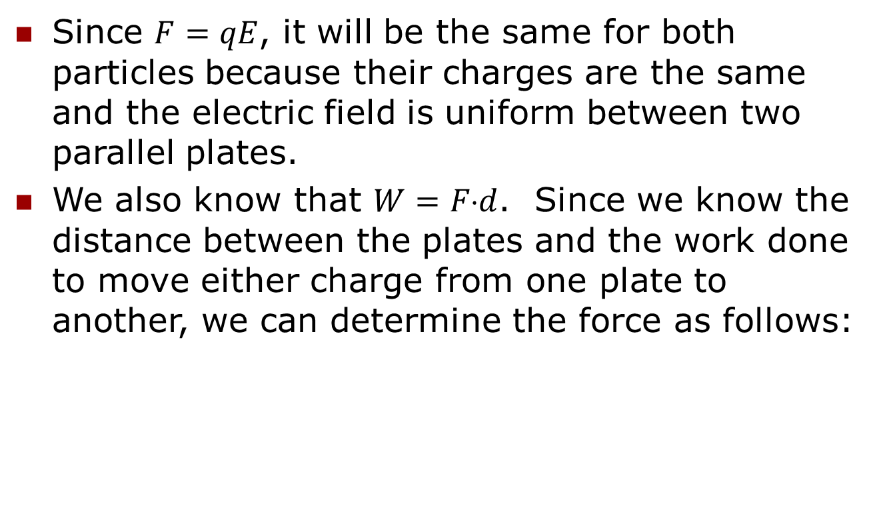
Example 4: Parallel Plates(#4)
Since $F=qE$, it will be the same for both particles because their charges are the same and the electric field is uniform between two parallel plates.
We also know that $W=Fd$. Since we know the distance between the plates and the work done to move either charge from one plate to another, we can determine the force as follows:
$$F_{net}=\frac{W}{d}=\frac{1.6×{10}^{−14}J}{1.0×{10}^{−4}m}=1.6×{10}^{−10}N$$

Slide 11
Example 4: Parallel Plates(#5)
Since we have the force acting on each particle, we can now calculate the acceleration of each particle using Newton’s 2nd Law.

